Slide 1
Welcome

Slide 2
Business Process Automation
Class – 02

Slide 3
What we will do today
Variables

Slide 4
Variables
Variables are containers that can hold multiple data entries (values) of the same data type.
EmailAddress can be a variable that holds the value "rpadeveloper@uipath.com".
Likewise, the speed of a car, the age of a person, bank account balance, and marks obtained in an examination are some examples of variables.
The value of a variable can change through an external input, data manipulation, or passing from one activity to another.

Slide 5
Main properties in UiPath
Name
Variable type
Scope
Default

Slide 6
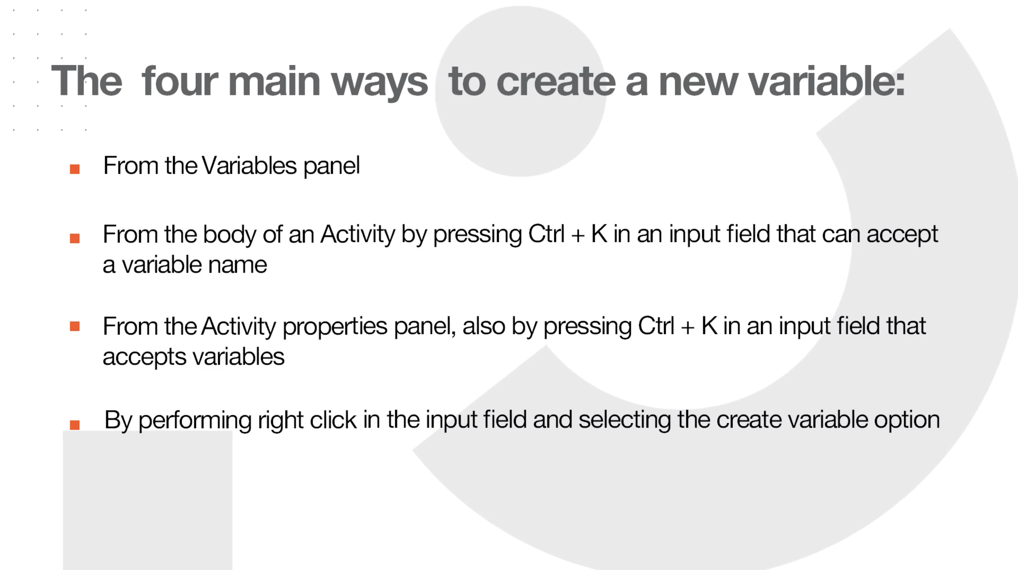

Slide 7
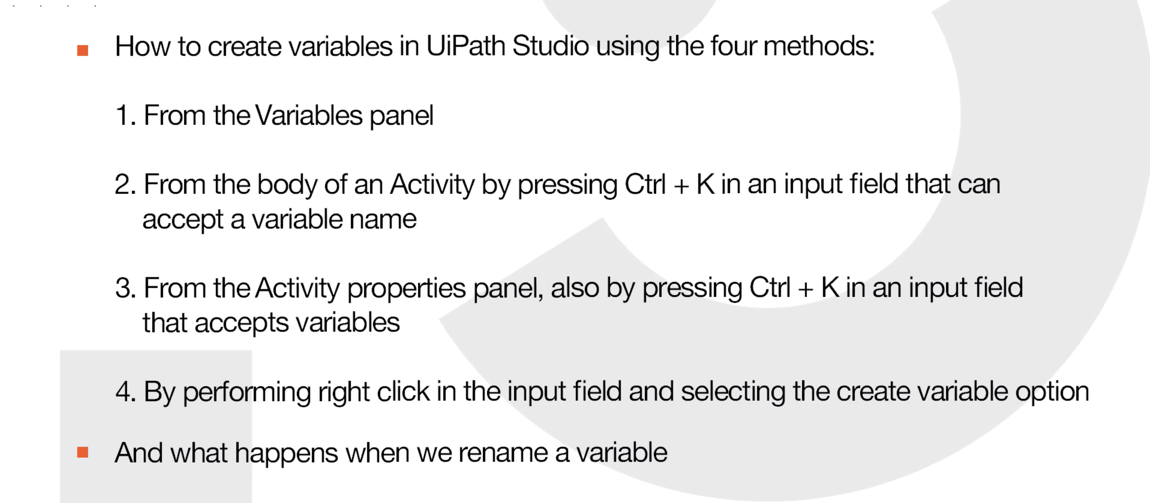

Slide 8
Data Types
Data types used in UiPath Studio.
Most of them are borrowed from Visual Basic.NET language.
What are data types?
Data Types describe what type of data a variable can hold.
For example, if the data type is Int32, then the variable must hold an integer number.

Slide 9
String
System.String: used to store text. This type of data comes with many specific methods of processing, and will be addressed in depth in another lesson, namely Data Manipulation with Strings in Studio.

Slide 10
Numeric
Used to store numbers. There are different sub-types of numerical variables. For a few examples:
Int32 - System.Int32 (signed integers): 10, 299, -100
Long - System.Int64 (long integers): 54354353430, -11332424D
Double - System.Double (allows decimals, 15-16 digits precision): 19.1234567891011

Slide 11
Booleans
System.Boolean: Used to store one of two values – True or False.

Slide 12
Scope
Scope and Hands on !!

Slide 13
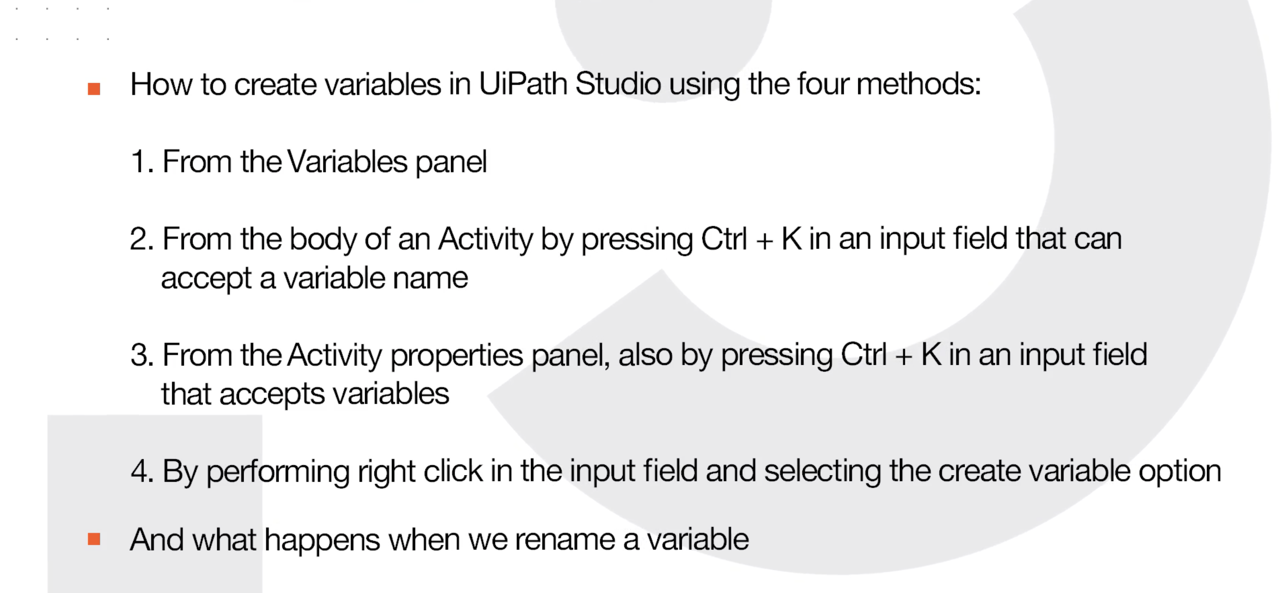

Slide 14
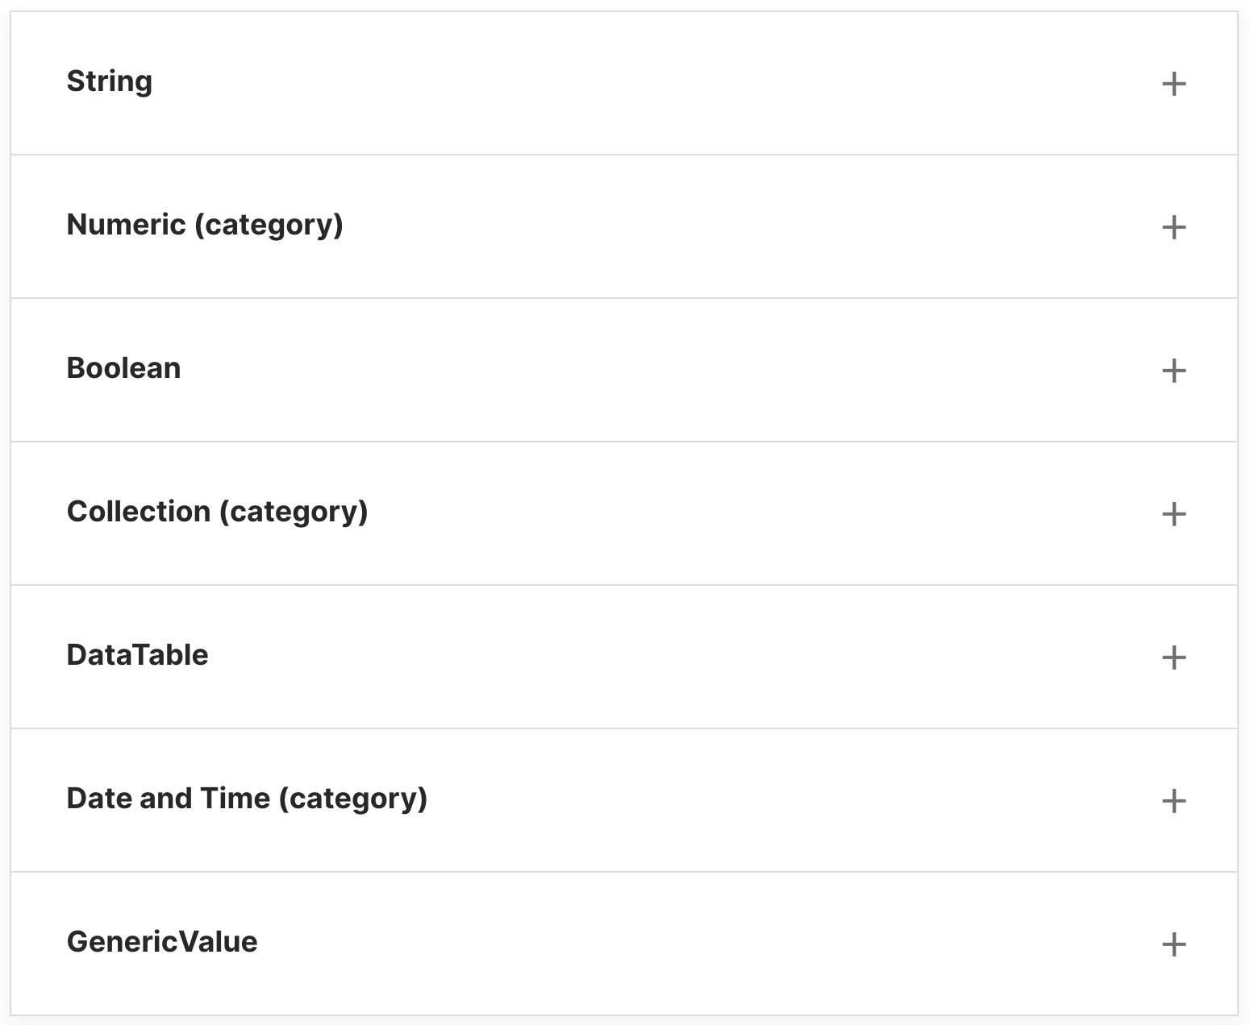
Some of the most common ones data types

Slide 15
GenericValue
While developing an automation process, there are situations where you are not sure what type of data is retrieved. In order to find out, you need to run a few tests using a variable with a broad enough spectrum that can catch any type of input.
This is where we recommend temporarily using GenericValue Variables.

Slide 16
GenericValue - What is it?
The GenericValue (UiPath.Core.GenericValue) data type is particular to UiPath and can store any kind of data, including text, numbers, dates, and arrays.

Slide 17
What are some business scenarios in which you will use GenericValue?
Data is extracted from a UI field and forwarded to another workflow without processing.
Two versions of the same Excel file are being compared column by column. The columns are different in terms of data type, the only relevant thing is which entries have changed.

Slide 18
Conversion methods of Data Types
These are ways of changing an expression from one data type to another. For example, conversion of an integer to string or vice versa.
Here's a list of some of the conversion methods commonly used for data types.

Slide 19
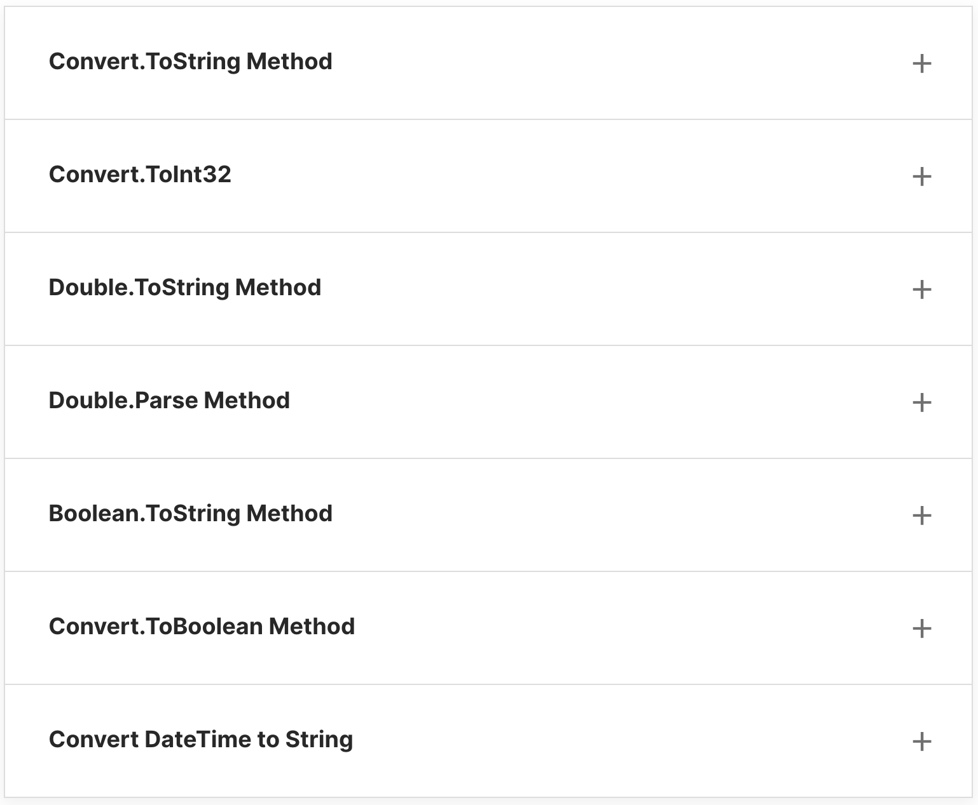

Slide 20
Invoke Workflow File and Arguments
Explain what arguments are and what they are used for.
Use the Invoke Workflow File Activity to chain workflow execution and pass data through arguments.
Differentiate between variables and arguments.

Slide 21
What is a workflow?
A workflow represents a relatively small piece of an automation project, typically executing a specific part of the process. Once built, it can be reused across different projects.
A workflow is made of Studio activities, interconnected through variables to form a routine. The routine typically has an input and an output. Basically, it defines the flow of automation. Hence the name, workflow.
UiPath Studio provides you with predefined workflow layouts to suit all the needs of a fast and reliable automation process.

Slide 22
The workflow layouts are:
Sequences
Flowcharts
State Machines
Global Exception Handler

Slide 23
Why is it important?
The fastest, most reliable, and useful way of automating a process is to break it down into smaller bits.
This allows for independent testing of components, enables team collaboration, and component reuse.
Hence, most of the automation projects require the use of multiple workflows that come together to provide a solid business automation solution.

Slide 24
Arguments
What are arguments?
Arguments are very similar to variables:
They store data dynamically.
They have the same data types.
They support the same methods and properties.
The difference is that they pass data between workflows, and they have an additional property for this – the direction. Arguments have specific directions: In, Out, and In/Out. These tell the Robot where the information stored in them is supposed to go.

Slide 25
Why are they important?
Arguments are a key component when it comes to building more complex automation, where you need to store and use data between multiple workflows.

Slide 26
Hands On !!

Slide 27
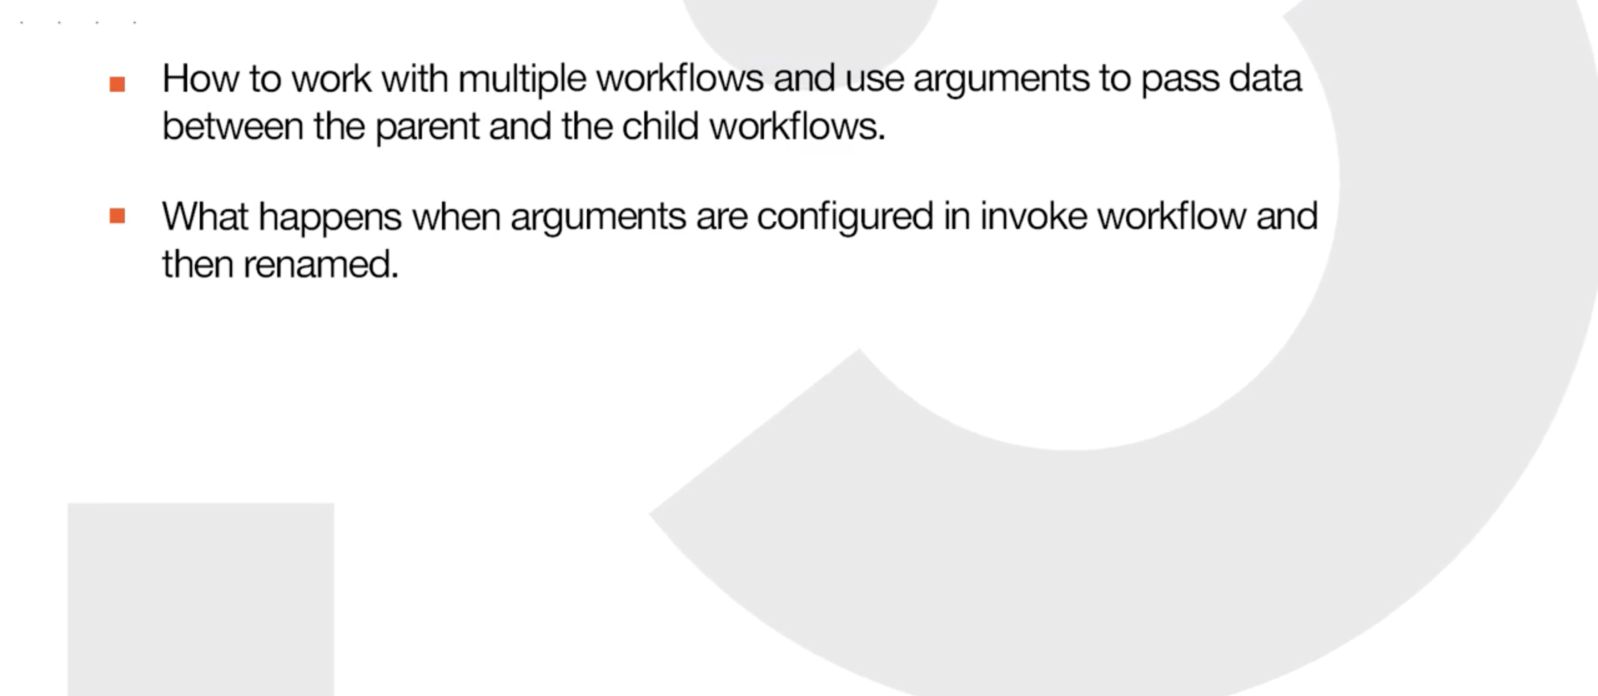

Slide 28
Variables vs Arguments
Variables | Arguments
Used to pass data from one activity to another within a workflow. | Used to pass data dynamically between automation.
Don't have directions like In, Out, or In/Out. | Do have directions like In, Out, In/Out.
To create a variable press: Ctrl + K. | To create an In Argument press: Ctrl +M. To create an Out Argument press: Ctrl+Shift+M.
To create variables, there must be at least one activity in the Designer Panel. | Arguments can be created if the Designer panel doesn't contain any activity.
Variables aren't used with the Invoke workflow file and Launch workflow Interactive activities. | Due to their nature, arguments are used a lot in relation with the Invoke workflow file and Launch workflow Interactive activities.
Require a defined scope. | Do not require a scope.

Slide 29
Arrays
Most of the examples shown up to this point were simple variables and arguments, which could store a single value at a time. It’s time to look at a collection: the array.

Slide 30
What are Collections?
If you have data entries that are similar, like invoice numbers, book names, and account numbers, and you want to group them together, then collections come in handy.
They're data types that allow the storage of entries of the same base data type as elements of one variable.
This way, you can work both with all the objects in the collection variable and with each object.
To make this work, the name of the collection variable and its position in the collection can identify the objects of a collection.

Slide 31
Let's take the example of an Array of Strings:
StrArray = {"John", "Paul", "George", "Ringo"}
StrArray(0) = "John”
The beauty of a collection is that each object is dynamic and can change its value as the workflow is executed.
Moreover, some collection data types allow the unit holding the objects to grow or shrink accordingly.
Not all collection types can grow or shrink. In fact, arrays are the most common example of a collection with a fixed size, the one at creation.

Slide 32
Array - What is it?
An array variable or argument is a type that enables storing multiple values of the same data type.
Think of it as a group of elements with a size that is defined at creation, and where each item can be identified by its index.
In UiPath Studio, you can create arrays of numbers, of strings, of Boolean values, and so on. All these arrays are of fixed size and cannot be increased dynamically.

Slide 33
What are some business scenarios in which you will use arrays?
When you want to save the names of the months to a variable.
When a fixed collection of bank accounts has to be stored and used in the payment process.
When all the invoices paid in the previous month have to be processed.
When the names of the employees in a certain unit have to be verified in a database.

Slide 34
Disclaimer !!
As a good case practice, arrays are used for defined sets of data (for example, the months of the year or a predefined list of files in a folder).
Whenever the collection might require size changes, a List is probably the better option.

Slide 35
Hands on !!

Slide 36
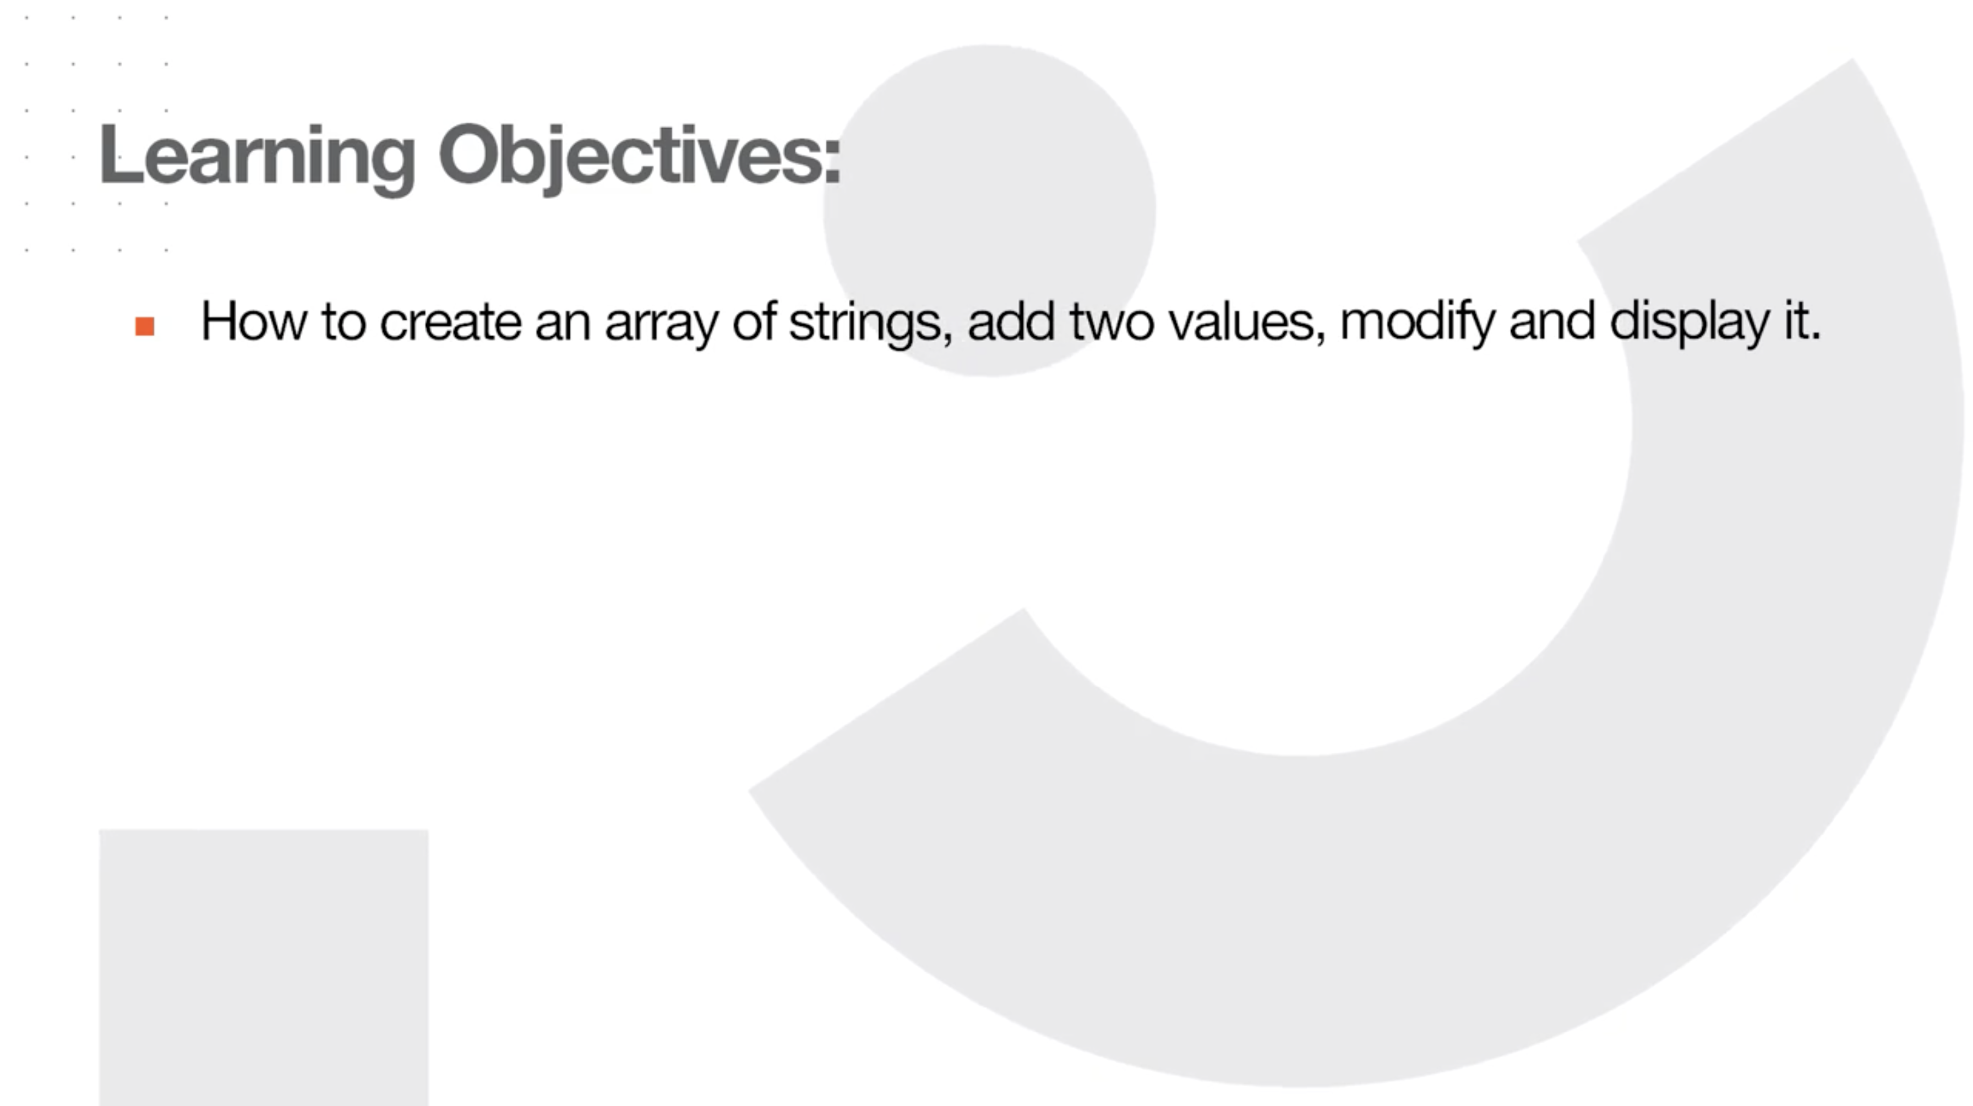

Slide 37
Problem Statement: Create a simple interest calculator using separate workflows and arguments
1. Create a simple interest calculator.
2. In the ‘Main’ workflow, ask the user to enter the amount of the initial deposit and the period by using multiple-choice options E.g.: 1 year,
3 years, 5 years). 3. Store the input in two variables.
4. Create a third variable that will store the value of the final earnings.
5. Create a new workflow to calculate the simple interest using the user input and the year.
6. The formula to calculate the interest can be Deposit Amount x Rate per year x Period chosen / 100.
7. Set the Rate per year to 1.75 for all deposit periods.
8. Pass the result back to Main.xaml and display on-screen the accumulated interest at the end of the period and the final deposit balance.
Output: Display a message box with the accumulated interest at the end of the period and the final deposit balance.

Slide 38
Hints
vbLf = visual basic line feed: This will add a new line in the text. Similar methods: Environment.NewLine, "\n", "\r\n".
Math.Round = rounds the floating number to a given precision.
Eg: Math.Round(2.34123, 2) = 2.34; Math.Round(2.34678, 2) = 2.35.

Slide 39
Solution:
To solve the exercise in this Practice lesson, use the following steps: Main.xaml
1. Start a new project as a sequence. Provide a relevant name, location, and description.
2. Define two variables of type Double, ‘DepositAmount’ and ‘FinalEarning’, define a third variable ‘DepositPeriod’ of type Int32, and set its default value to 1.
3. Inside the body of the sequence, drop another Sequence activity and rename it as ‘Sequence for inputting the principal amount and deposit period.’
4. Add two Input Dialog activities into the inner sequence followed by a Log Message activity to log the entered deposit amount and period.
5. Configure the first Input Dialog to ask the user to input the principal amount and assign it to the DepositAmount variable.
6. Configure the second Input Dialog to have the user input the deposit period. Set the Input Type to Multiple Choice and the options array to {“1”, “3”, “5”}. Assign the output to the DepositPeriod variable.
7. To create a new sequence, select ‘Design’ tab > ‘New’ > ‘Sequence’, name it as ‘SimpleInterestCalculator’ and make sure the location is set to where your Main.xaml file is. Next, hit ‘Create’.

Slide 40
That’s it

Slide 41
Thanks

